Slide 1

By: Azizbek Husainov, Rasheed Abbasov, Blake Ebert, Sergio Ngyen, Salah Maarouf

Slide 2

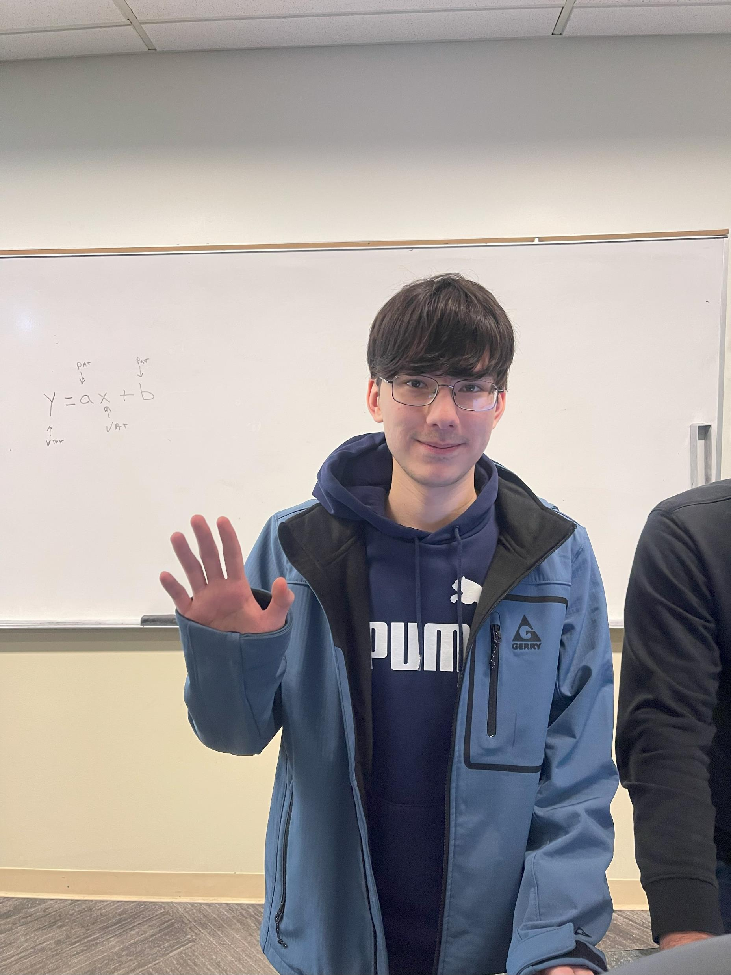
Azizbek Husainov
Computer Science Major
Java

Slide 3
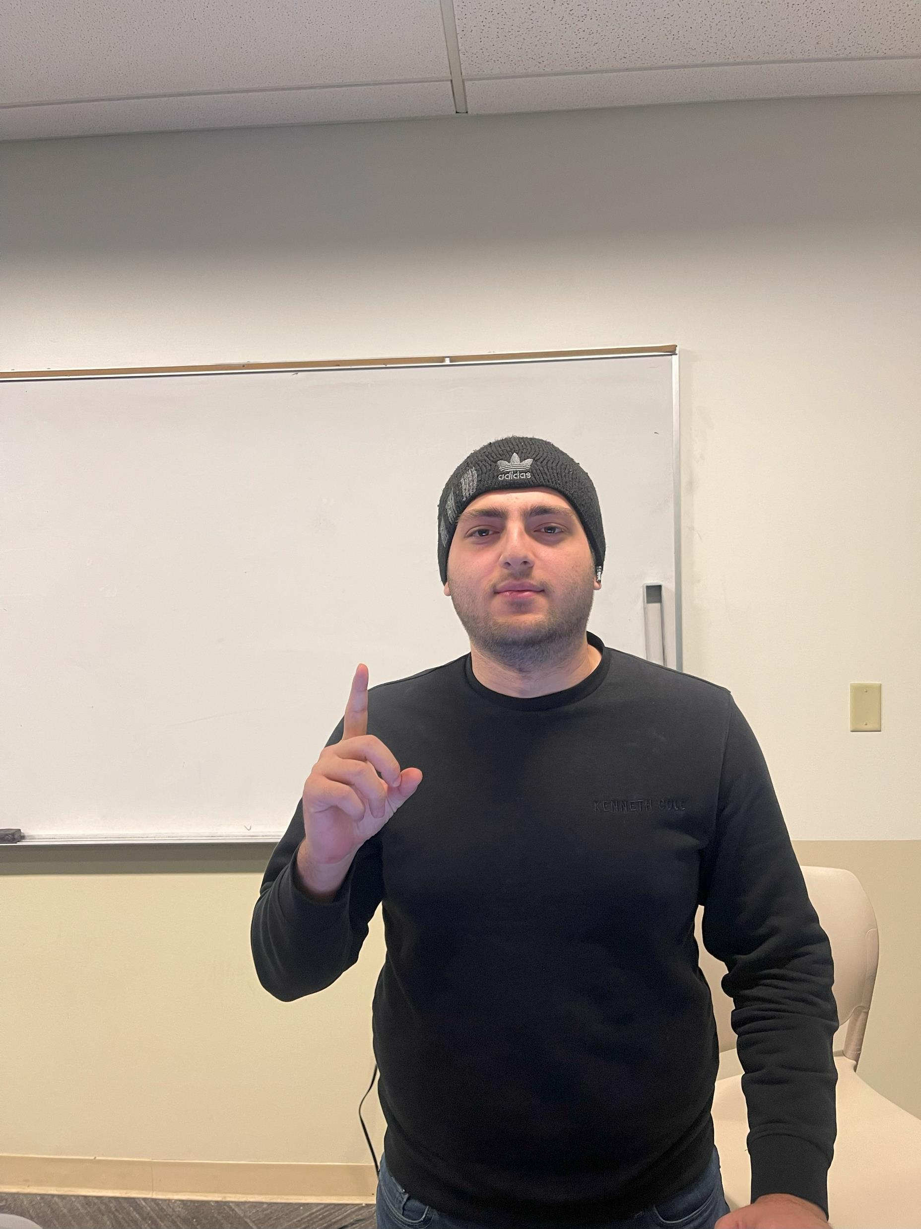
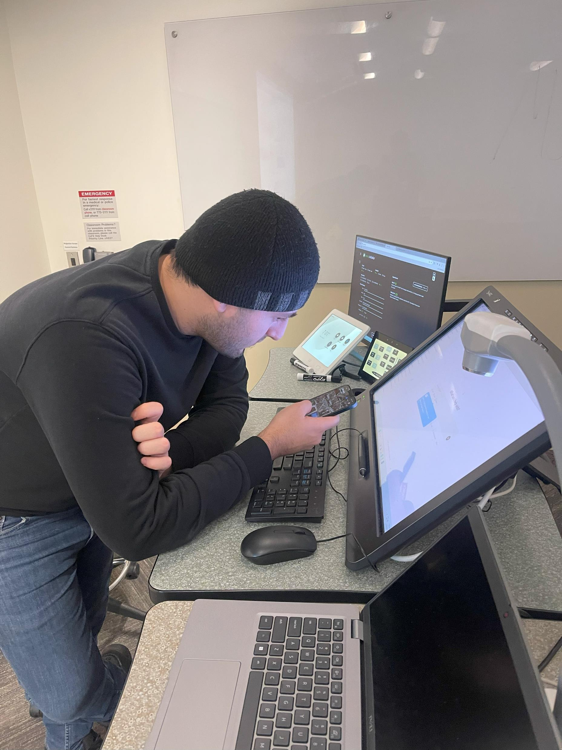
Rasheed Abbasov
Computer Science
Java

Slide 4
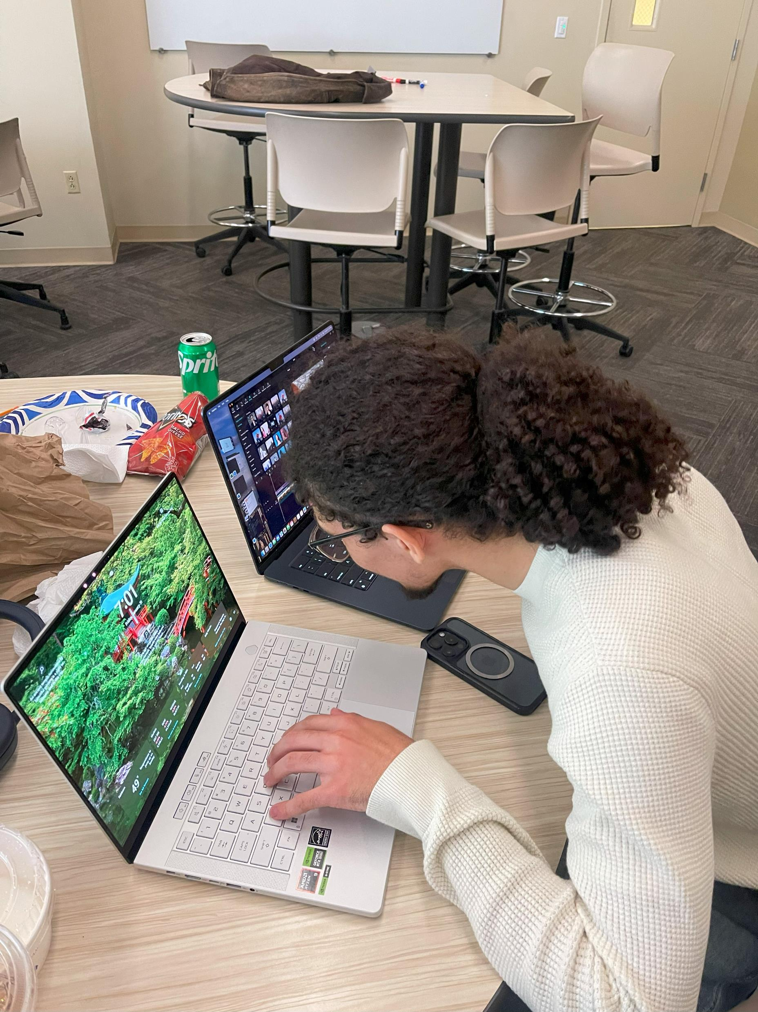
Blake Ebert
Cyber Security
Java

Slide 5
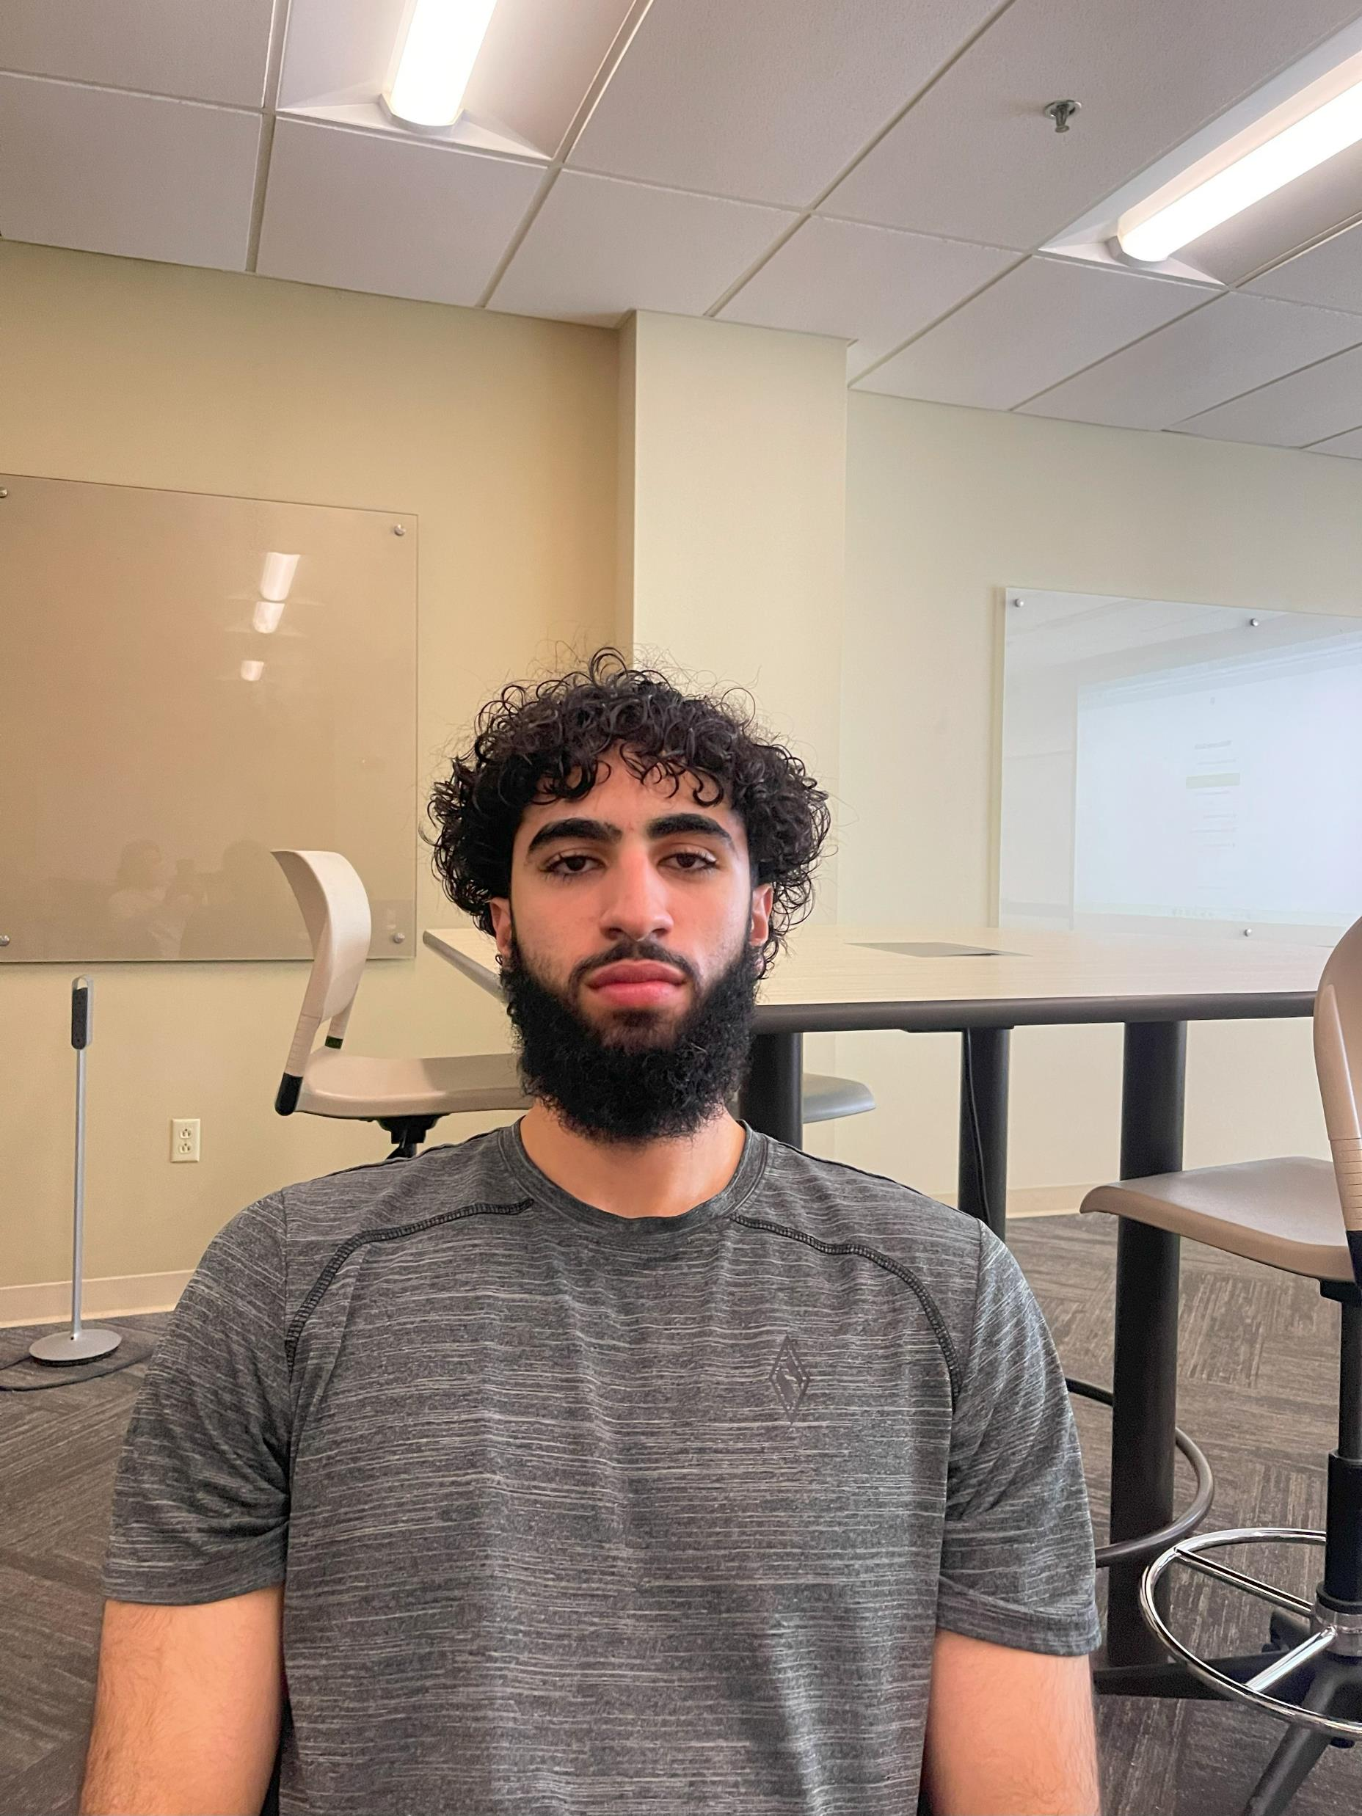
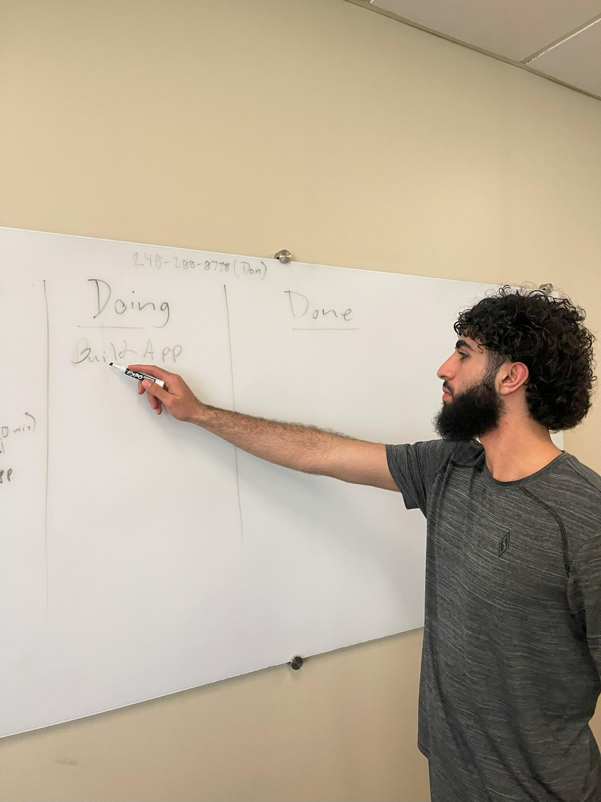
Salah Maarouf
Biomedical Engineering

Slide 6

Sergio Nguyen

Slide 7

Our Goal

Slide 8
Deepen
Deepen our understanding of JAVA
Learn
Learn Spring Framework
Research and experience
Research and experience AI APIs
Achieve
Achieve feeling of accomplishment

Slide 9

Our Vision

Slide 10
A humanized AI experience
Support for students
Overall positive impacts

Slide 11

What is Motiv.ai?
Motiv.Ai is an Artificial Intelligence powered platform aimed to give more human like responses as quick as regular AI.
The issue with AI right now is the unfortunate fact that when you talk to it, you can immediately tell it is a computer talking to you. It is missing that real feel.

Slide 12
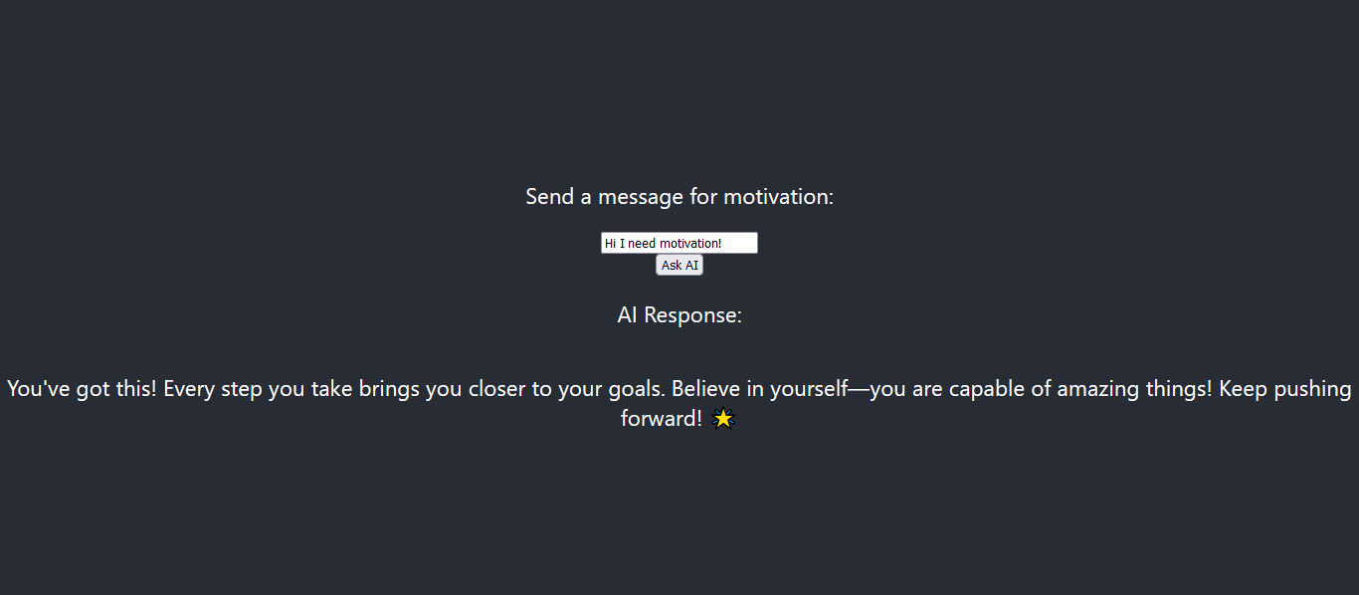
Motiv.AI in Action

Slide 13

Benefits

Slide 14
Our target audience is primarily college students.
Some students struggle getting the proper help they need, or that they can afford. By using this motivational AI chat bot, their info is protected and they can get help.

Slide 15

Standards/Technology

Slide 16
JAVA
OpenAI API
Springboot Framework
Node.js
Docker

Slide 17

How would we enhance?

Slide 18
More humanized responses
Better user interface
Faster loading times

Slide 19

Any Questions?

